Slide 1

The Exchange Hub

Slide 2
Elevator Pitch
Introducing phase 1 of our website that provides a one-stop solution for investors and traders, allowing them to easily access up to 5000 companies on the stock market. As well as this they can save, they’re favourite stocks to keep track of more easily.

Slide 3
Concept
Description
Overview: The exchange Hub is an online platform that allows investors and traders to view historical price data for stocks. The platform will offer real-time data, as well as interactive charts and graphs to help users track trends and make informed investment decisions.

Slide 4
concept
Motivation for development
It was the idea we all come up with as a group and had current knowledge on.

Slide 5
concept
User story
As an Investor
I WANT: a website I want a website I can see the latest and historic stock prices
So that: I can keep an eye on the current market and compare old prices
THEN: I want to be able to save my favourite stocks to a list
So that: I can access them more easily

Slide 6
process
Technologies used
HTML
CSS
JAVASCRIPT
CHART JS
JQUERY
MATERIALISE
GOOGLE FONTS
ALPHA VANTAGE API
FINHUB API

Slide 7
process
Breakdown of tasks and roles
Initial HTML layout
CSS styling
Java script
Polishing html
Polishing CSS
Polishing JAVASCRIPT
Fixing of any final issues
Final testing of web application
Deployment of web application

Slide 8
process
success

Slide 9
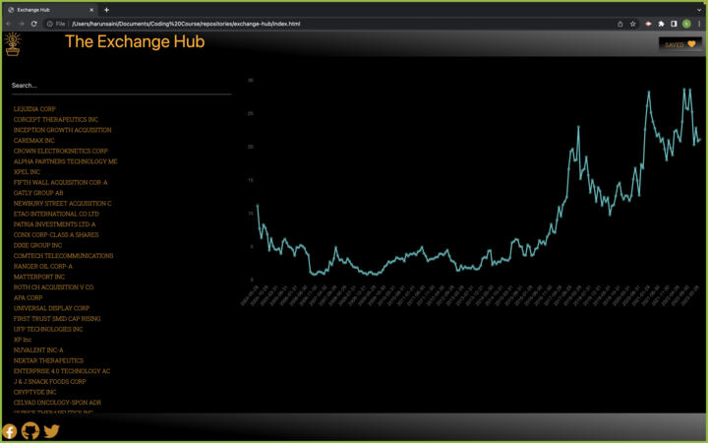
demo

Slide 10
process
Challenges
Finding the right bootstrap alternative
Finding the right api’s that will work for out application
Getting the api’s to work
Merging new code without getting conflicts
Future updates
In the future we would like to add crypto currency and a news page, so that investors can keep up with all the breaking news regarding stocks, shares and crypto

Slide 11
Links
Project
GIT HUB REPOSITORY: https://github.com/darylbg/exchange-hub
DEPLOYED LINK: https://darylbg.github.io/exchange-hub/
Our Git Hub Accounts
DARYL - https://github.com/darylbg
ASHLEY - https://github.com/Dovahkiin1993
HARUN - https://github.com/193G

